Slide 1

DEPARTMENT OF ARTIFICIAL INTELLIGENCE AND MACHINE LEARNING
20AM6203 - DESIGN PROJECT - II
Batch - 6
Presented by :
Guided by :
Barani Dharan V.S - 811722001005
Hans Benedict A - 811722001011
Lakshmi Narayanan P - 811722001027
Ms. S. Murugavalli ,
Associate Professor / AI

Slide 2
PROJECT TITLE
AI-POWERED ENGINEERING TOOL

Slide 3
OBJECTIVE
AI-Powered Engineering Tool uses AI and prompts to create websites, blogs, and portfolios easily, making web development faster and more efficient to user.

Slide 4
EXISTING SYSTEM
Engineers rely on separate software tools like MATLAB and AutoCAD, which are not AI-powered or integrated.
Manual coding is required for website and portfolio creation, making the process time-consuming
Demerits
No natural language assistance for technical queries.
Time-consuming and less accessible for non-programmers.
Limited personalization and intelligent recommendations.

Slide 5
PROPOSED SYSTEM
AI-powered web platform automates website, blog, and portfolio creation using prompts.
Natural Language Processing (NLP) allows users to describe their needs in plain language.
Merits
Improved accessibility for both technical and non-technical users.
Unified platform integrates engineering tools and learning resources.
Personalized recommendations enhance user experience and efficiency.

Slide 6
LITERATURE SURVEY
S.No | TITLE | AUTHOR | YEAR | TECHNIQUES USED | DEMERITS
1 | A Systematic Literature Review on the Integration of AI in Software Engineering Phases and Activities (2013–2023) | Durrani. | 2024 | Keyword clustering and phase-wise classification | Lacks implementation case studies, focuses more on historical data.
2 | AI-Driven Smart Manufacturing for Industrial Equipment Lifecycle: A Comprehensive Review | Xiaohong Zhang. | 2023 | AI applications in predictive maintenance, diagnostics, and lifecycle optimization. | Primarily industry focused on limited applicability for academic or general-purpose engineering tools.

Slide 7
LITERATURE SURVEY
S.No | TITLE | AUTHOR | YEAR | TECHNIQUES USED | DEMERITS
3 | A Research Agenda for Generative AI in Software Engineering. | Nguyen-Duc, Hosek, Franch. | 2023 | Analysis of AI generated code automated debugging and development optimization | Lacks quantitative performance analysis; focuses more on potential than validated results.
4 | Artificial Intelligence in Digital Twin Systems: A Systematic Mapping Study. | A. M. Da Silva | 2024 | AI techniques (e.g., neural networks, reinforcement learning) used in digital twins. | Scope limited to digital twin applications; not generalized for broader engineering tools.

Slide 8
LITERATURE SURVEY
S.No | TITLE | AUTHOR | YEAR | TECHNIQUES USED | DEMERITS
5 | Generative AI Tools for Literature Reviews in Engineering Research. | BCU Library Research Group | 2024 | Tool evaluation (e.g., R Discovery, Semantic Scholar) based on ease of use, keyword tracking, and relevance scoring. | Focused only on literature analysis; does not involve AI use in solving engineering problems directly.

Slide 9
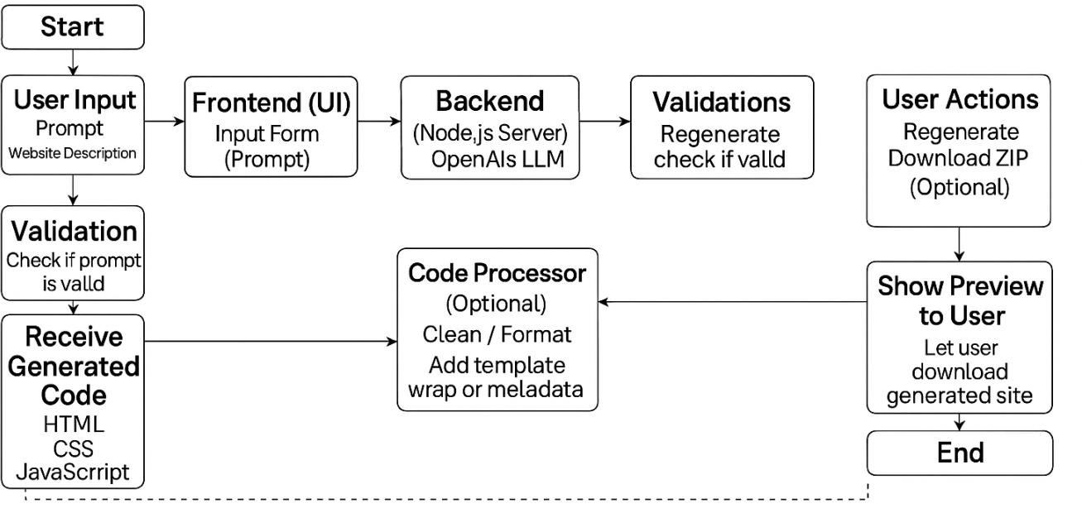
FLOW DIAGRAM

Slide 10
SYSTEM & SOFTWARE SPECIFICATIONS
SOFTWARE SPECIFICATIONS
HARDWARE SPECIFICATIONS
Operating System (Windows / macOS / Linux)
Front-End Framework (React.js / Vue.js)
Back-End Framework (Django / Flask / Node.js)
Database (PostgreSQL / MongoDB / MySQL)
AI/ML Libraries
Processor (CPU)
RAM (Memory)
Storage (SSD/HDD)
Graphics Unit (GPU or Integrated Graphics)
Display Monitor
Network Interface (Internet Access)

Slide 11
MODULES
Prompt Interpretation Module
Website Code Generator Module
Preview & Export Module

Slide 12
PROMPT INTERPRETATION MODULE
PURPOSE
Processes user input in natural language, extracting key design elements and translating them into structured data for website creation.
Functions
Detect_website_type() – Identifies the type of website (e.g., blog, portfolio, e-commerce) from user input.
Extract_components() – Extracts pages, features, and design preferences from the prompt.

Slide 13
Algorithm Used
Named Entity Recognition (NER) using spaCy : Identifies keywords like website type, pages, and features from the prompt.
Text Tokenization & Vectorization : Breaks down user input and converts words into structured representations.
Intent Recognition – Uses word embeddings and similarity matching to determine user intent (e.g., creating a blog vs. portfolio).

Slide 14
WEBSITE CODE GENERATOR MODULE
PURPOSE
The Website Code Generator Module converts structured data into HTML, CSS, and JavaScript. It uses Jinja2 for HTML templates, generates styles based on user preferences, and adds dynamic features through JavaScript, producing a complete website ready for deployment.
Functions
generate_html(config_data) - Converts the structured data (e.g., pages, sections) into dynamic HTML code using templates.

Slide 15
generate_css(config_data) - Generates CSS styles based on the user’s design preferences (e.g., theme, fonts, layout).
generate_js(config_data) - Generates JavaScript code based on user-defined dynamic features, such as form validation, interactivity, or custom behaviors.
Algorithm Used
Jinja2 Templating Engine – Dynamically generates HTML based on predefined templates.
CSS Rule Mapping – Maps extracted design preferences (e.g., colors, fonts) to CSS styles.
JavaScript Behavior Modeling – Uses pattern-based logic to generate interactive website components.

Slide 16
PREVIEW & EXPORT MODULE
PURPOSE
The Preview & Export Module is responsible for allowing users to preview the generated website before finalizing it and exporting the code for deployment.
This module ensures the user can see what the website will look like in real-time and get the website files in a downloadable format
Functions
generate_preview() – Displays a live preview of the generated website.
export_website_files() – Packages website files into a downloadable ZIP.

Slide 17
Algorithm Used
Flask Web Server – Serves the website preview dynamically using the generated code.
Zip Compression using zipfile – Packages HTML, CSS, and JavaScript into a compressed format for easy download.
HTTP Request Handling (Requests Library) – Manages interactions between frontend and backend.

Slide 18
APPLICATIONS
Project Documentation
Engineering Problem Solving
Educational Assistance
Decision Support System

Slide 19
ADVANTAGES
AI-Driven Automation
User-Friendly Interface
Dynamic Content Generation

Slide 20
CONCLUSION
The AI-Powered Engineering Tool transforms web development by integrating AI-driven automation and prompt engineering, making website creation faster and more accessible.
By reducing manual effort, offering personalized recommendations, and enabling natural language interactions, it simplifies complex processes for engineers and students

Slide 21
REFERENCES
Wu, J., Gan, W., Chen, Z., Wan, S., & Lin, H. (2023). AI-Generated Content (AIGC): A Survey, arXiv.
Cao, Y., Li, S., Liu, Y., Yan, Z., Dai, Y., Yu, P. S., & Sun, L. (2023). A Comprehensive Survey of AI-Generated Content (AIGC): A History of Generative AI from GAN to ChatGPT, arXiv.
Wen, Z., Cao, J., Wang, Z., Guo, B., Yang, R., & Liu, S. (2025). InteractiveSurvey: An LLM-based Personalized and Interactive Survey Paper Generation System, arXiv.

Slide 22
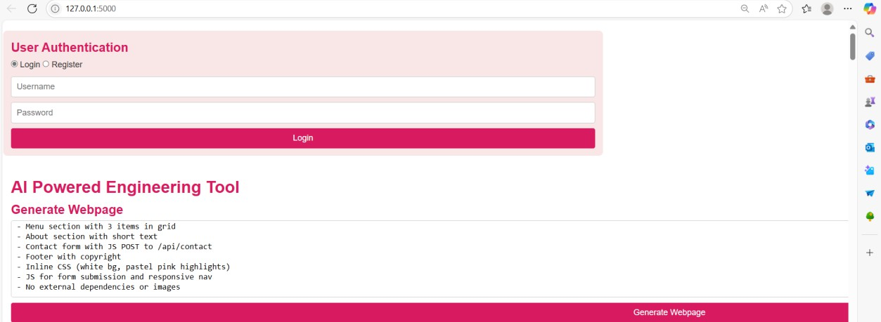
SCREENSHOTS

Slide 23
